Slide 1

Hackathon Project on UrbanLadder
TEAM NAME: FUTURE 5
TEAM MEMBERS:
DHARSHINI.T(851265)
HARSHANKUMAR.M(851190)
NAVANEETHAN.S(851228)
BALAJI(851207)
VELAMMAL.P(851254)
COACH: Ms. SUNDARA LAKSHMI
TRAINER: Mr. A.V.S. MURALI MOHAN

Slide 2
SCOPES AND REQUIREMENTS
Display the name, price of Bookshelves below Rs. 15000 Excluding out of stock Storage type should be open. Take first 3 study chair details with highest recommendation If more than one item with same price displayed, include that details as well. (Suggested site: urbanladder.com however you are free to use any other legitimate site) | Display the name & price of first 3 Bookshelves below Rs. 15000, with Storage type as open & exclude out of stock From Collections, retrieve all sub-menu items under Being-At-home and store in a List; Display the same Gift cards - choose "Birthday/Anniversay"; fill customize the gift card; fill from to details with any one input invalid (example: email); Capture & display the error message (Suggested site: urbanladder.com however you are free to use any other legitimate site)

Slide 3







COMPONENTS USED

Slide 4
Multi-Browser Testing

Slide 5
pom.xml

Slide 6
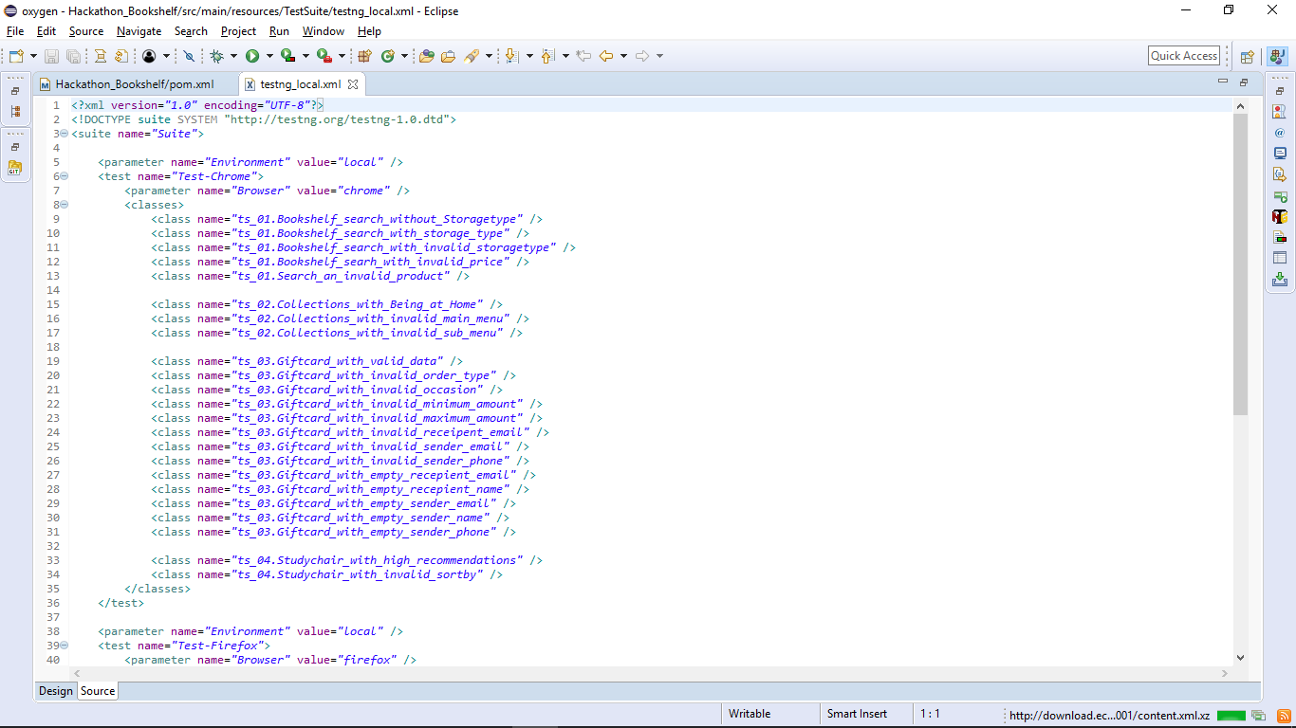
testng.xml

Slide 7
DATA-DRIVEN FRAMEWORK

Slide 8
REPORT MAKEING

Slide 9
CLEAR CODE

Slide 10
ERROR/EXCEPTIONAL HANDLING

Slide 11
LOCATOR SELECTOR PRIORITY

Slide 12
FUNTIONAL LIBRARIES

Slide 13
SELENIUM GRID

Slide 14
The node is the one which does the work ordered by its master or the hub
The orders from the hub are excuted in the driver with which it was registered
And a node can run the commands from its master only if it has the corresponding driver in it
The hub is the master of all nodes
It instruct's the nodes to do a work
A particular hub creates a unique IP in which all the nodes are registered

Slide 15
CUSTOMISED TEST RESULTS

Slide 16
JENKINS

Slide 17
FOLDER STRUCTURE

Slide 18
NAMING CONVENTIONS

Slide 19
CODE COMMENTS

Slide 20
SCREENSHOTS

Slide 21
WEB-PAGE SYNCRONIZATION
WAIT INTERFACE USAGE

Slide 22
THINKS WE LEARNT
How to handle a real time project work.
Proper time management in finishing weekly tasks.
How team work and coordination can help to handle situations.
How proper planning and work distribution can reduce time consumption.

